Slide 1
AI Travel Itinerary Generator
Generative AI + Personalization
CAP 4630 – Intro to Artificial Intelligence
Team: Curtis Williams , Kylie Capes and Mackenzie VanMeter
Notes:
Open with the motivation: simplifying trip planning through personalized AI itineraries.

Slide 2
Objectives
Problem Overview
Solution Overview
System Architecture
Pipeline Diagram
Demo Walkthrough
Evaluation (Cost & Latency Charts)
Limitations
Future Work
Conclusion
Notes:
Briefly describe the problem: travelers want AI help that is truly personalized.

Slide 3
PROBLEM
Travelers require fast, personalized itineraries
Planning trips manually is time-consuming and stressful
Estimating accurate budgets is challenging
Numerous tools provide generic or partial suggestions
Notes:
Explain the full-stack design. Flask handles UI, LangChain handles LLM prompts.

Slide 4
SOLUTION
• AI-powered itinerary generator utilizing OpenAI and LangChain
• Personalized activities tailored to user interests and budget
• Structured daily schedule divided into morning, afternoon, and evening
• Automatic budget estimation feature
• Web interface with JSON output
Notes:
Show the pipeline logic step-by-step. Emphasize prompt structure importance.

Slide 5
SYSTEM Architecture
• User submits trip preferences
• Flask server receives request
• LangChain builds structured prompt
• OpenAI LLM generates itinerary JSON
• Python parses + validates JSON
• Budget module calculates costs
• HTML template displays final itinerary
Notes:
Discuss your prompt design philosophy and improvements from trial runs.

Slide 6
PIPLINE DIAGRAM
The pipeline diagram represents the process flow starting from User Input, which includes destination, budget, party size, and dietary preferences. This input is sent to the Flask Server, which then forwards it to the LangChain Prompt. The prompt interacts with the OpenAI Model to generate responses. The responses undergo JSON Parsing, followed by processing through the Budget Calculator. Finally, the output is displayed on the Web UI.
Notes:
Describe your live demo or screenshots of app results.

Slide 7
Live Demo
https://8876cc40-604c-49f4-a2f6-9ec1e60d9b32-00-w8z19ng1r46u.picard.replit.dev/
(Hosted on Replit)
Demo Slide
Notes:
Explain that gpt‑4o‑mini is faster at low token counts, while gpt‑4.1 scales slower but richer responses.

Slide 8
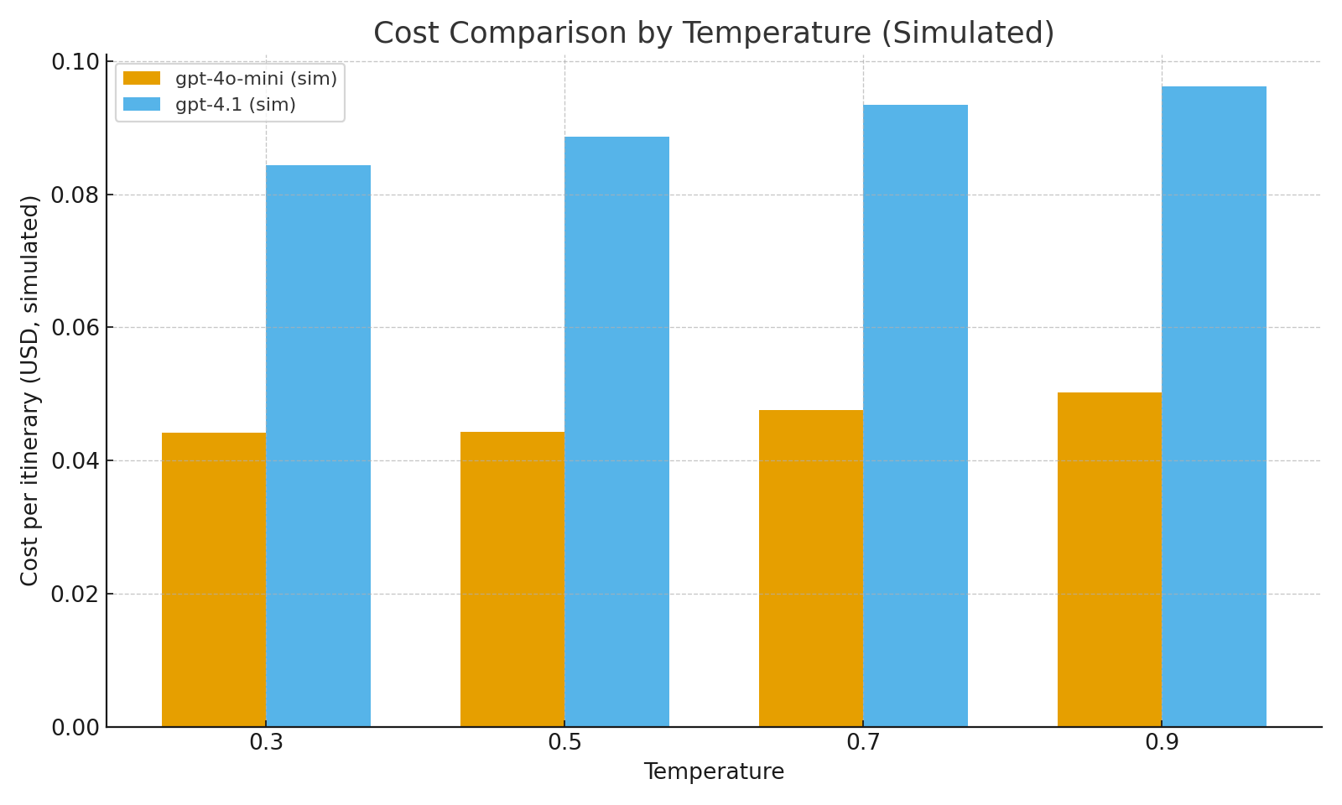
EVALUATION SLIDE ( LATENCY)
Notes:
Compare simulated costs; explain optimal temperature for balance between creativity and cost.

Slide 9
EVALUATION SLIDE ( COST COMPARISON)
Notes:
Summarize what worked best and why.

Slide 10
Limitations
Requires stable internet connection and API availability
Language model outputs may occasionally be inconsistent
Budget estimates are approximate and not sourced
Limited access to real-time data such as weather, events, and prices
Notes:
Be transparent about constraints; propose retrieval‑augmented enhancement.

Slide 11
FUTURE WORK SLIDE
Integrate live weather and event data
Add hotel and flight recommendation APIs
Implement user accounts and saved itineraries
Enhance real-time budget accuracy
Notes:
Future roadmap—align with applied AI best practices.

Slide 12
Conclusion
In conclusion:
AI has the potential to streamline and customize travel planning.
Our system produces detailed and high-quality daily itineraries.
It integrates budgeting, clear explanations, and supports multiple models.
Future enhancements aim to enable fully real-time operation and increased intelligence.
Notes:
End confidently—highlight innovation, scalability, and relevance to AI in daily life.

